Slide 1







3D Tank game
Presentation

Slide 2
Our Team
Mahmoud AMR_(320230087)
Mohamed Adham_(320230001)
Ahmed Hesham_(320230205)

Slide 3
1. overview
The project is a 3D Tanks Game developed using Unity 3D.
The game is played from a third-person perspective.
The player controls a tank in a 3D environment.
The game focuses on movement, aiming, and shooting mechanics.
The environment includes terrain and obstacles that affect gameplay.
The game demonstrates basic game development and computer graphics concepts.

Slide 4
2. Tools & TECH STACK
• Game Engine: Unity
• Language: C#.
• IDE: Visual Studio.
• Version Control: Git / GitHub.
•Assets:
- AUDIO
3D tank models, terrain assets, particle effects

Slide 5
3. Gameplay Mechanics
Tank Movement:
Forward and backward movement using keyboard input.
Rotation of the tank body for steering.
Shooting System:
Tank fires projectile shells.
Physics Interaction:
Rigidbody and colliders are used for realistic movement and collisions.
Camera System:
A third-person follow camera tracks the tank smoothly.

Slide 6
Shooting system
MinLaunchForce 15f
MaxLaunchForce 30f
MaxChargeTime 0.75f
Charging the shot based on how long the fire button is held
Displaying the shot power using a UI slider
Spawning and launching shells using Unity physics
Handling player input for firing shells
Playing appropriate shooting sounds

Slide 7
controls
Red Tank
W/ S: Move Forward / Backward
A/ D: Rotate Tank
Space: Fire shell
Esc: Pause / Exit
Blue Tank
Up arrow / down arrow: Move Forward / Backward
Left arrow / Right arrow: Rotate Tank
Enter: Fire shell
Esc: Pause / Exit

Slide 8
.
4. Graphics Techniques
Camera Transformations:
Third-person follow camera with position offset.
Smooth camera movement using interpolation.
Lighting:
Directional light simulates sunlight.
Real-time shadows enhance realism.
Texture Mapping:
Textures applied to tank models and terrain using UV mapping.
Particle Effects:
Explosion effects when shells hit targets.
Muzzle flash when firing.
Animations:
Tank movement using transform

Slide 9
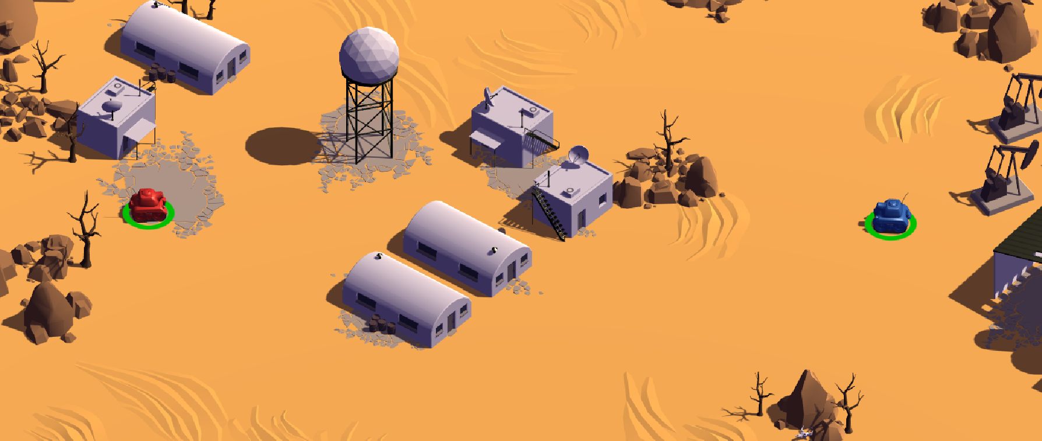
.
Terrain

Slide 10
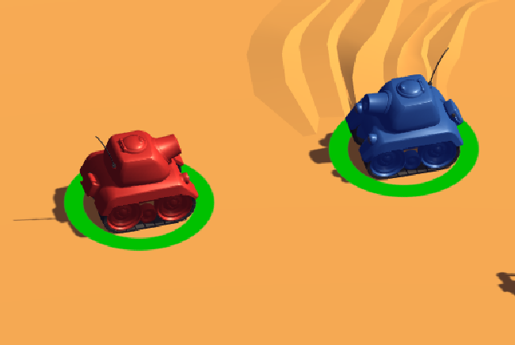

.
Health bar representation
Final score

Slide 11
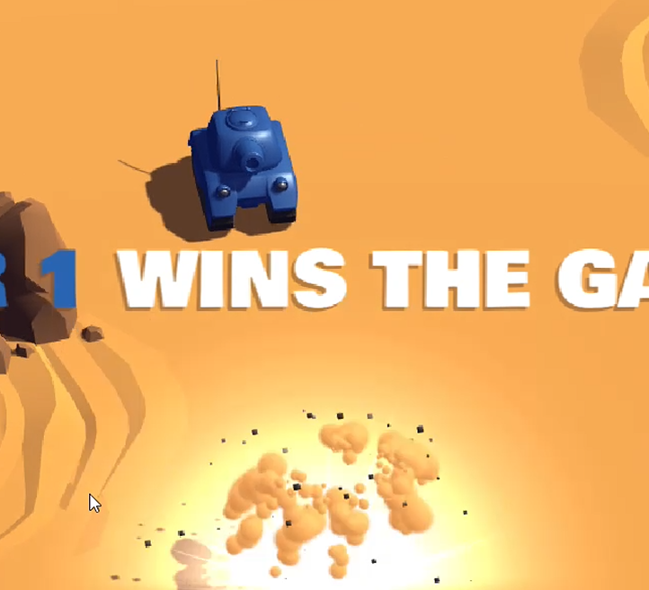
.
Tank Explosion

Slide 12
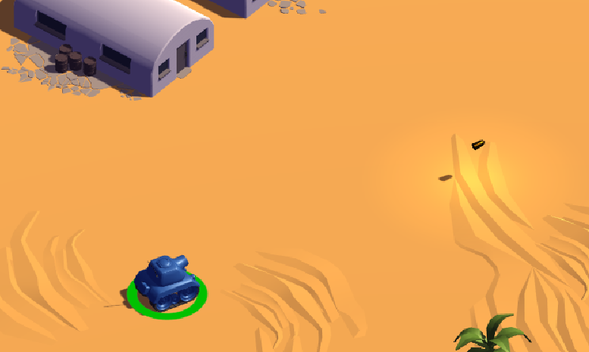
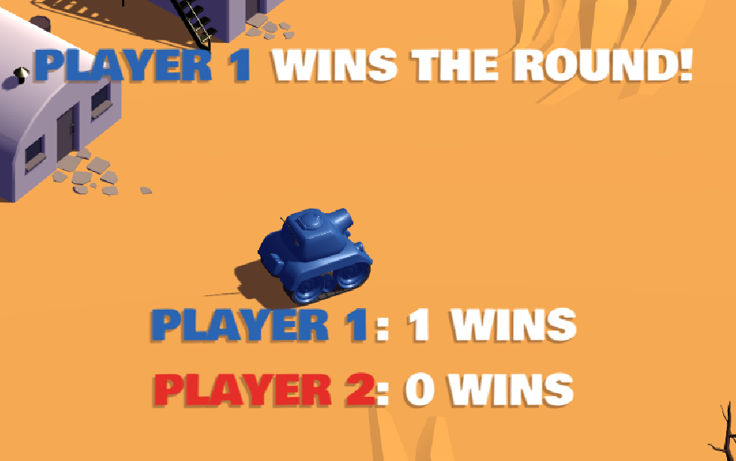
.
Tank firing
Score Update

Slide 13
.
5. Conclusion
The 3D Tanks Game successfully demonstrates core Unity and computer graphics concepts.
The project applies camera transformations, lighting, textures, and particle systems.
The game provides a smooth and interactive gameplay experience.
This project helped improve understanding of C# scripting, game physics, and 3D graphics.
The project can be extended by adding enemies, health systems, and multiple

Slide 14
QnA Time

Slide 15

Thank You

